Slide 1
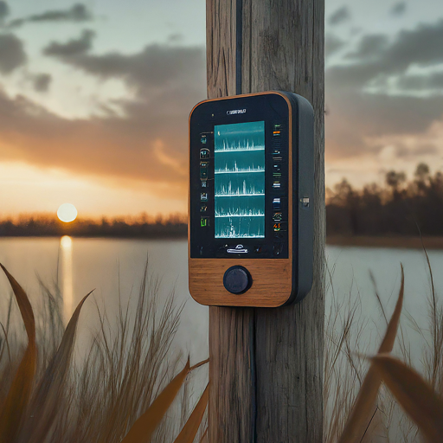
Implementation of compact
tank water level measuring
system
Supervised by,
Bidhan Pramanick
Team Members,
- Hasitha Varshini Thatikayala
- Utsav Bansal
- Vinod Kumar

Slide 2
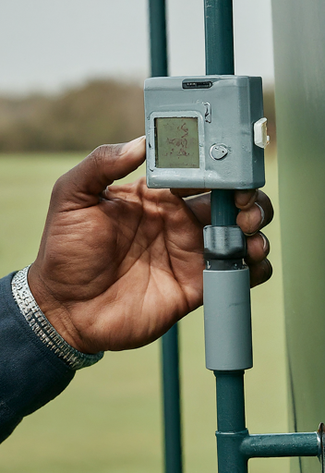
Table of contents
01
02
03
04
05
Problem Statement
Objectives
Changes
Current Status
Future Works

Slide 3
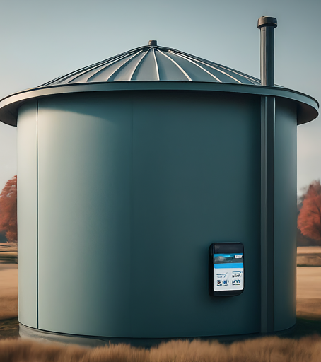
Problem Statement
A tank water level measuring system has already been developed and demonstrated. However, this system needs to be designed in a compact form. We need to use the IoT and cad Design.

Slide 4
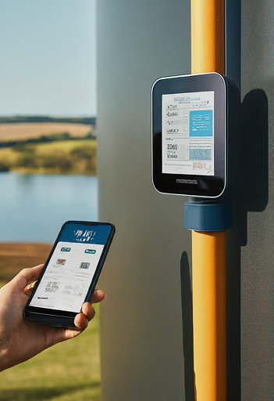
Objectives of the project
Design and implement a compact, automated water level measuring system for efficient water management.
Consisting of two primary devices: the Water Level Sensor Device and the Alert & Control Device.
The Key Features are Automation for convenient monitoring and control and Real-time water level tracking and alerts.
Additionally, the system will be integrated with IoT technology, providing users with a mobile application for remote control.
Benefits: Improved water management, reduced wastage, and enhanced convenience through automation.

Slide 5
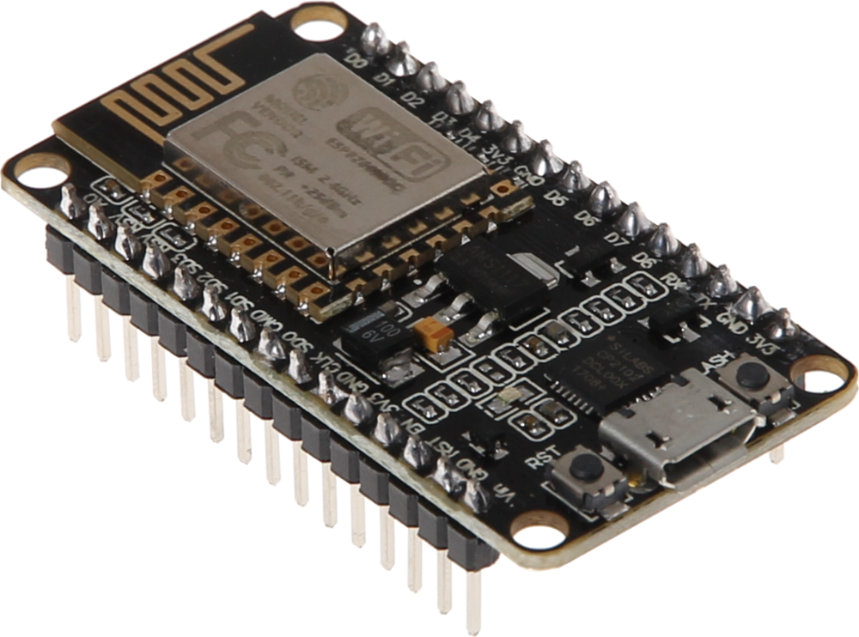
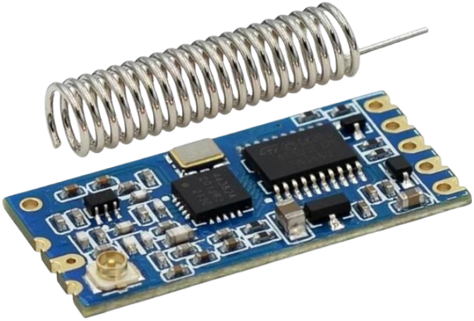
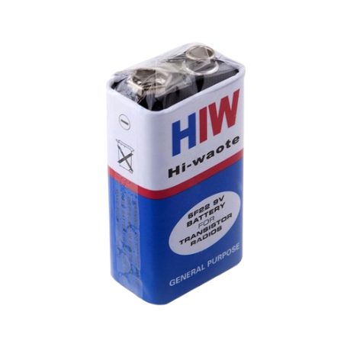
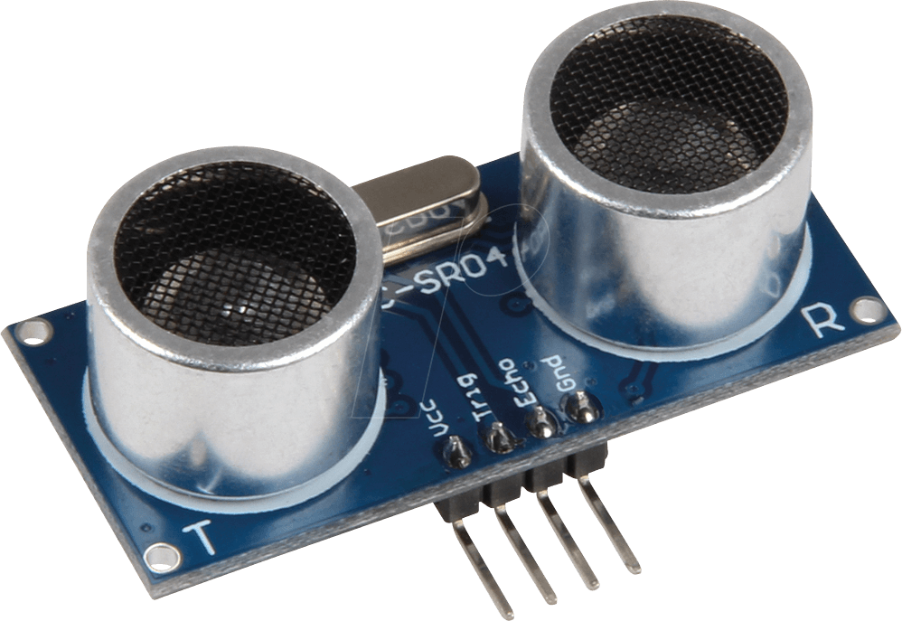
Components Used
Tank Device
ESP8266 Module
HC-12 Wireless Communication
Ultrasonic Sensor
Battery

Slide 6
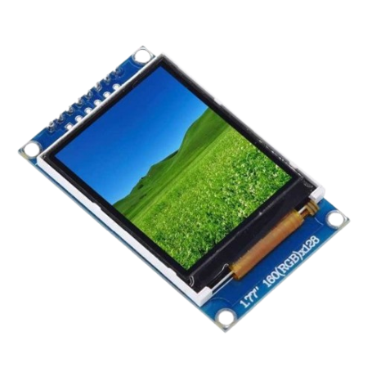
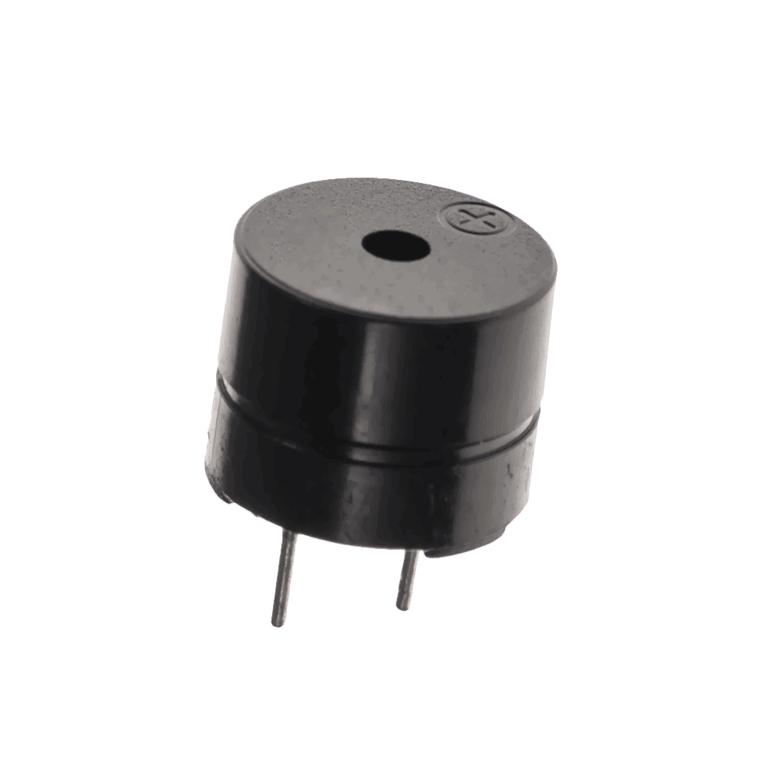
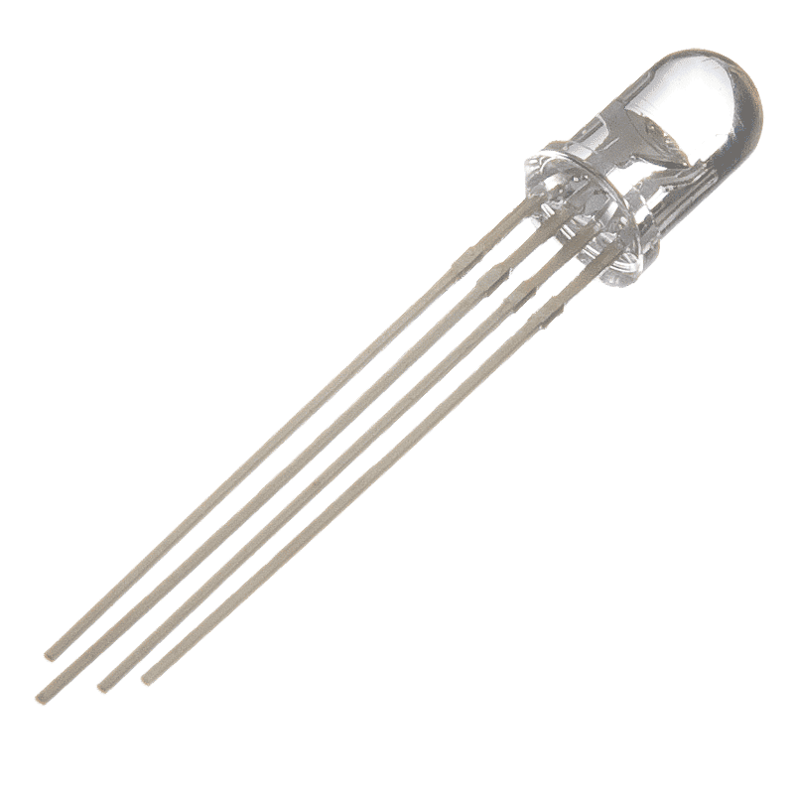
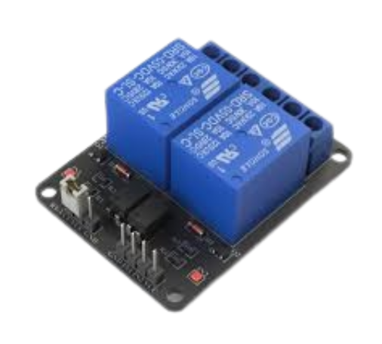
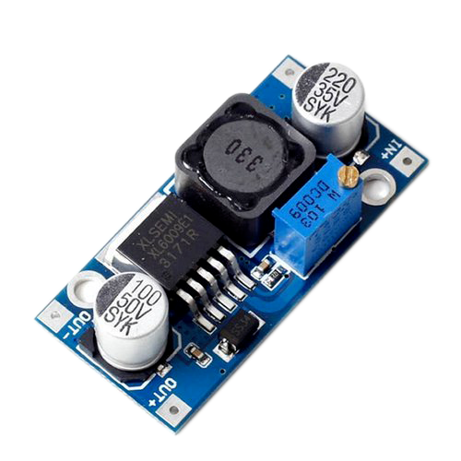
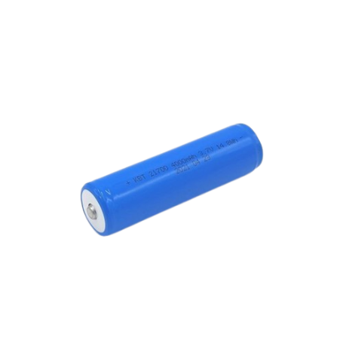
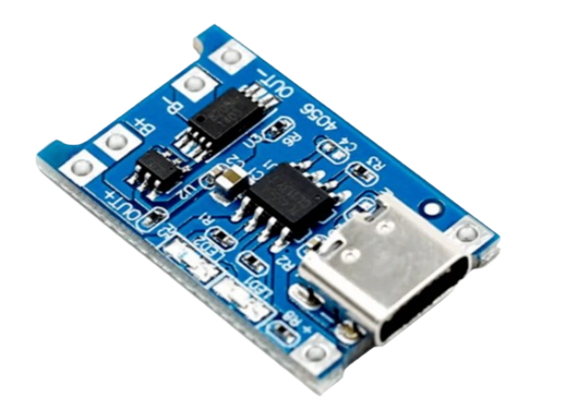
Alert Device
ESP8266 Module
HC-12 Wireless Communication
RGB LED
OLED Display
Buzzer
Li-ion Battery
2-Channel Relay
Resistors
TP4056
XL6009 Boost Module
Power Supply Circuit Board

Slide 7
Current Status
Project Planning Completed
Circuit Design Finalized
Individual Device Testing
The project has undergone detailed planning, outlining all aspects and requirements. New features have been integrated based on the initial review to enhance functionality and user experience.
Electrical schematics for both the Water Level Sensor and the Alert & Control Devices have been completed, with components selected to meet functional requirements.
Each device has undergone separate testing to ensure proper operation before system integration.

Slide 8
Current Status
Intermediate Coding Phase
Tank & Alert Devices Completed
Intermediate CAD Designing
Coding for sensor data handling, alerts, and communication between devices and the mobile app is in progress.
Both devices are fully operational, successfully transmitting and receiving data as required.
Currently working on the design of the water tank device, also in the intermediate phase.

Slide 9
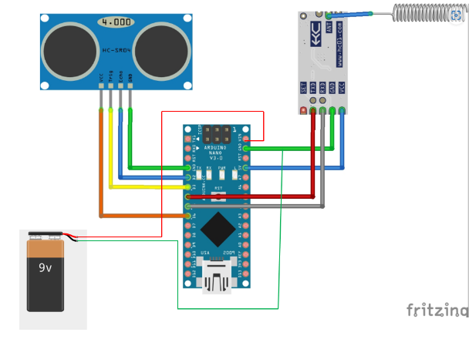
Circuit Diagram: Tank Device

Slide 10
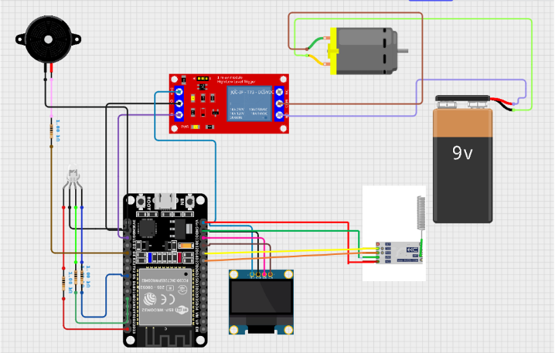
Circuit Diagram: Alert Device

Slide 11
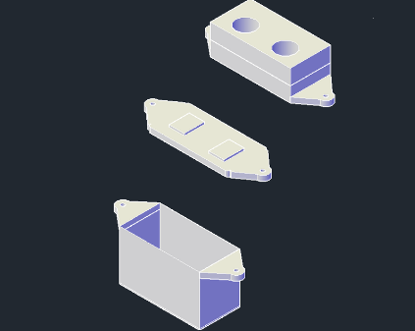
AutoCad Design of Tank Device

Slide 12

Demonstration

Slide 13
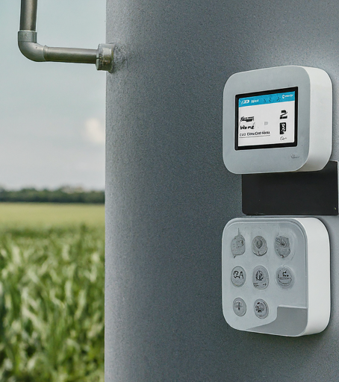
Future Works
Program Implementation
Develop and implement two distinct programs: one for manual pump operation and another for automatic operation based on water levels, allowing for both user-controlled and autonomous functionality.
Power Supply Integration
Utilize an AC power supply, converting it to DC using a rectifier to provide a stable power source for continuous operation of the system. AC will also be used to power the pump, reducing the need for frequent battery changes.

Slide 14
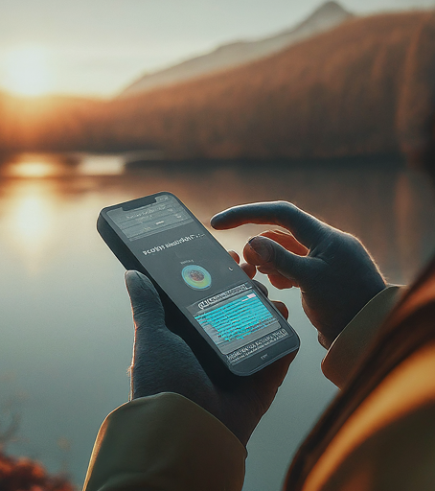
Future Works
CAD Design
Complete the CAD design for the Alert device, ensuring it meets the project's specifications and integrates well with other components.
Advanced UI Design
Implement an advanced user interface (UI) with a modern design to enhance user experience and improve navigation.

Slide 15
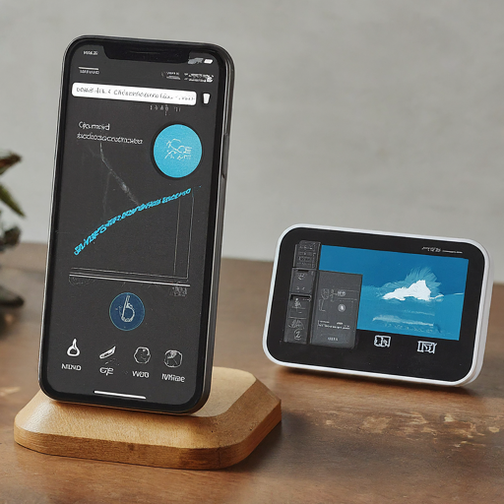
Thankyou

